Slide 1
Notes:
https://www.altexsoft.com/blog/engineering/graphql-core-features-architecture-pros-and-cons/

Slide 2
Notes:
Facebook's mobile apps have been powered by GraphQL since 2012.
A GraphQL spec was open sourced in 2015.

Slide 3
Notes:
Het bouwen van een interactieve app om je plek te reserveren voor een aankomende Space-X-lancering.
Alle gegevens zijn echt, dankzij de SpaceX API.
https://www.apollographql.com/docs/images/space-explorer.png
De app heeft vijf schermen: een inlogscherm, een lijst met lanceringen, een startdetail, een profielpagina en een winkelwagentje.
De grafische API die onze Space-app van stroom voorziet, maakt verbinding met een REST-API en een SQLite-database.
We behandelen essentiële onderwerpen zoals: authenticatie, paginering, testen en implementatie.

Slide 4
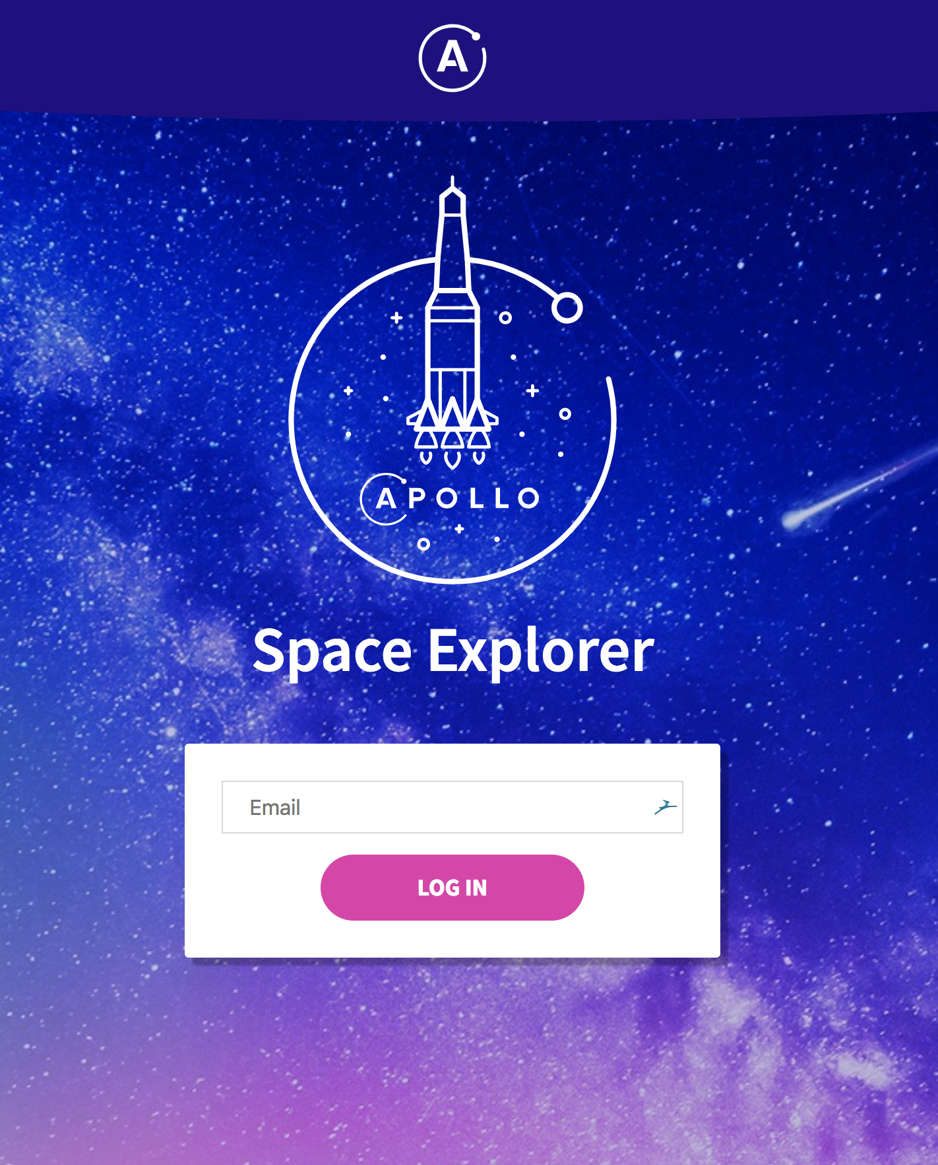

Slide 5
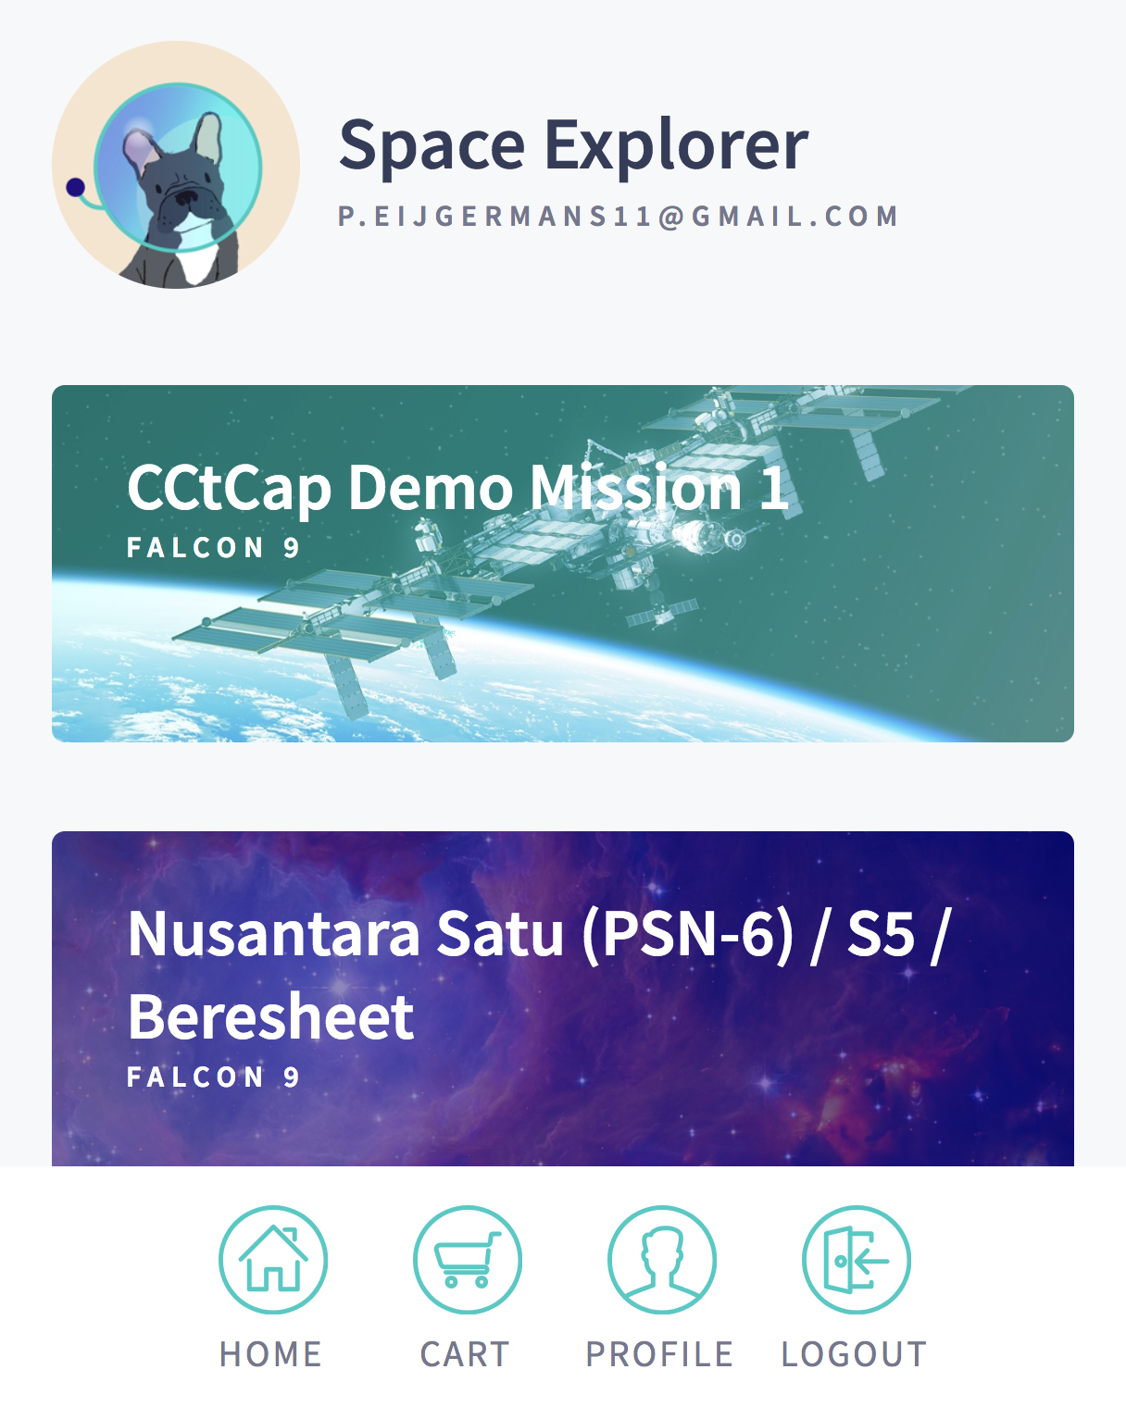

Slide 6
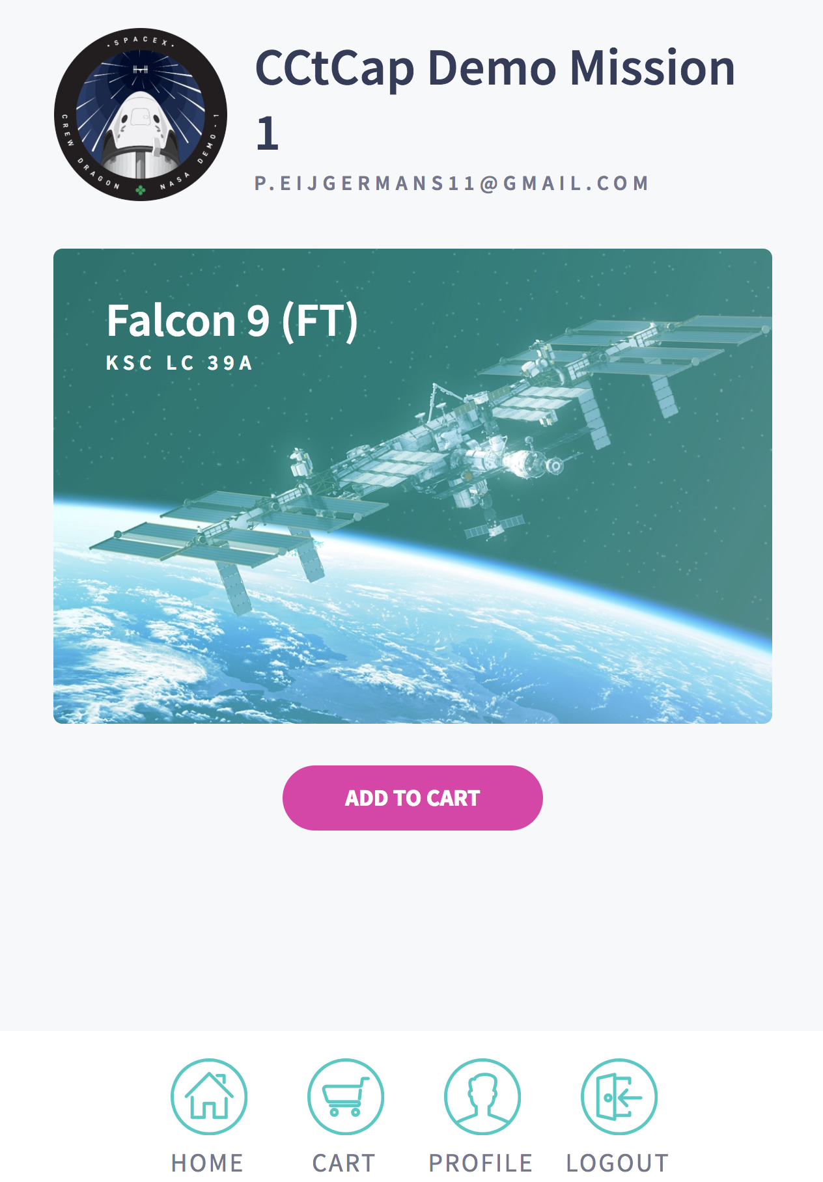

Slide 7
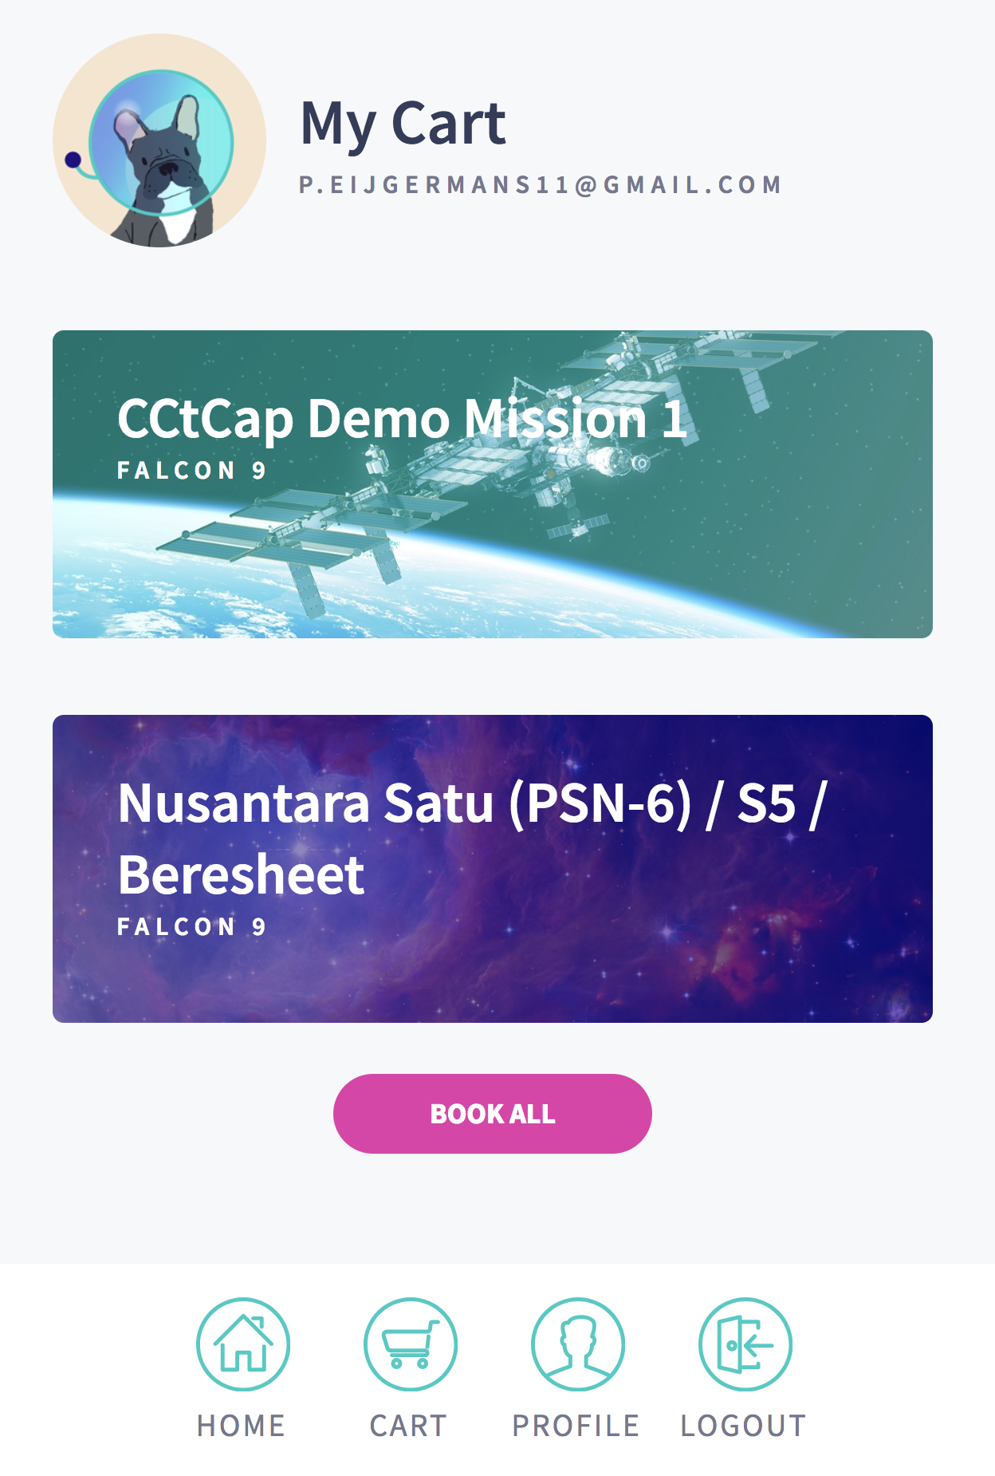
Notes:
Book SPACE-X lancering

Slide 8
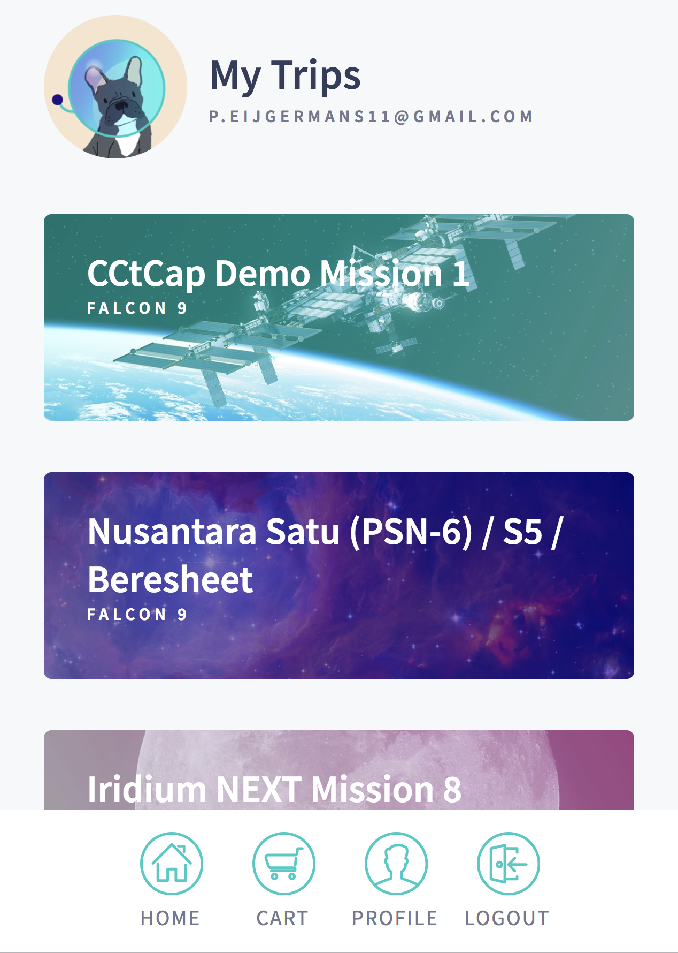

Slide 9
Where do GraphQL and Apollo live?

Slide 10
Notes:
APOLLO SERVER: HIER BOUW JE EEN API volledig afgestemd VOOR JE CLIENT
API = SCHEMA
GRAPHQL = execute queries
------
APOLLO SERVER: HIER DEFINIEER JE HET SCHEMA (= MODEL) VOOR ALLE UITGAANDE REQ en BINNENKOMENDE RESPONSES
https://www.apollographql.com/docs/apollo-server/
Apollo GraphQL Server:
Apollo Server is the best way to quickly build a API for GraphQL clients.
It is incrementally adoptable and can be layered over your existing services, including REST APIs and databases.
apollo-server: The Apollo server library which allows you to focus on defining the shape of your data (via a schema) and how to fetch it.
graphql: The library used to build a schema and to execute queries on that schema.
Apollo Client:
Jeroen Verhoeven gaat dit morgen behandelen.
Apollo Client: manages data and state in an application.

Slide 11
Apollo Client
Trigger queries as part of UI components
Binding query results to the UI
Caching
Integrations for React, React Native, Vue, Angular, Ionic, NativeScript

Slide 12
Apollo Server
Generic API = schema for the client
API layered over Backend services
Improved Performance → smaller payload
Caching
Notes:
Since the response back from the server contains only the properties you specify in your query, GraphQL can significantly reduce payload size compared to a REST endpoint.
Defining a generic API = schema for the client
API layered over your existing services, including REST APIs and databases
Improved Performance → smaller payload
Caching
Apollo is written in Node
GraphQL can be Node/Java/C# ect.

Slide 13
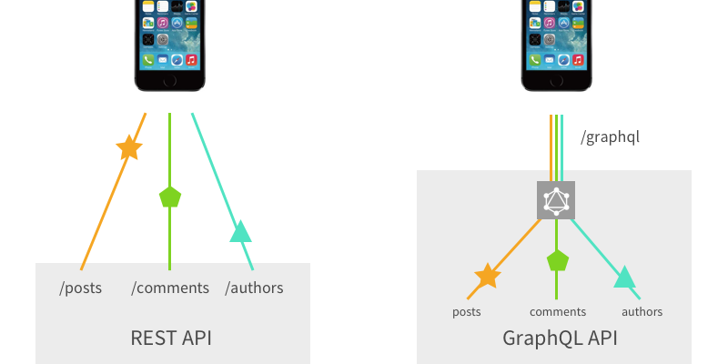
Smaller response/payload
Notes:
Different: In REST, the endpoint you call is the identity of that object. In GraphQL, the identity is separate from how you fetch it.
Different: In REST, the shape and size of the resource is determined by the server. In GraphQL, the GrapQL server declares what resources are available, and the client asks for what it needs at the time.
GraphQL request returns only one response!!!

Slide 14
REST
Notes:
REST: API gedefinieerd aan server zijde
GRAPHQL: API gedefinieerd aan de client zijde + afgestemd op de client

Slide 15
Notes:
https://www.altexsoft.com/blog/engineering/graphql-core-features-architecture-pros-and-cons/
Web caching opgelost met APOLLO
File uploading opgelost met APOLLO

Slide 16
GraphQL Advantages

Slide 17
Good fit for complex systems and microservices
Notes:
GraphQL aggregating data from multiple places into a single API

Slide 18
Fetching data with a single API call

Slide 19
Tailoring requests to your needs
Validation and type checking
API evolution without versioning
Authentication
Rapid application prototyping
Subscriptions
Notes:
https://www.altexsoft.com/blog/engineering/graphql-core-features-architecture-pros-and-cons/
No over- and under-fetching problems. REST responses are known for either containing too much data or not enough of it, creating the need for another request. GraphQL solves this efficiency problem by fetching the exact data in a single request.
Validation and type checking out-of-the-box. GraphQL’s introspection feature allows for navigating into the types and discovering the schema to ensure apps only ask for what’s possible and in the appropriate format. That said, developers can see what the schema can query and how the data is set up there. Based on that, they can easily add new fields to existing queries through a GraphQL IDE. There’s no need to validate the data format, as GraphQL does it for you. Developers need only to write resolvers – how the data will be received.
API evolution without versioning. Evolving API entails a problem of having to keep the old version around until developers make the transition to the new one. So, with REST it’s common to offer multiple API versions. However, GraphQL eliminates the need for versioning by deprecating APIs on a field level. Aging fields can be later removed from the schema without impacting the existing queries. GraphQL enables that by creating a uniform API across the entire application that isn’t limited by a specific storage engine.
By using a single, evolving version, GraphQL APIs give apps continuous access to new features and encourage cleaner, more maintainable server code.
Autthentication. https://www.howtographql.com/advanced/5-common-questions/
Rapid application prototyping. → API/Schema kan je aan de voorkant bepalen (niet afhankelijk van de backend REST API’s)
Subscriptions In that way, GraphQL brings a new operation to the table – subscriptions, – which allows clients to receive real-time messages from the server. GraphQL subscriptions can be used for automatically sending notifications to the client when a new comment or data is added, or a message is received.

Slide 20
GraphQL Disadvantages

Slide 21
GraphQL Disadvantages
Overkill for small applications
File uploading
Notes:
Web caching complexity

Slide 22
3 Steps to build GraphQL API
Step 1: Build a schema = API
Step 2: Write a DataSource
Step 3: Get your data with Resolvers
Notes:
Since a schema sits in between your clients and your underlying services, it serves as a perfect middle ground for frontend and backend teams to collaborate.

Slide 23
Step 1: Build a schema = API
A GraphQL schema is the center
of any GraphQL server

Slide 24
Our schema will be based on these features:
Queries
Fetch all upcoming rocket launches
Fetch a specific launch by its ID

Slide 25
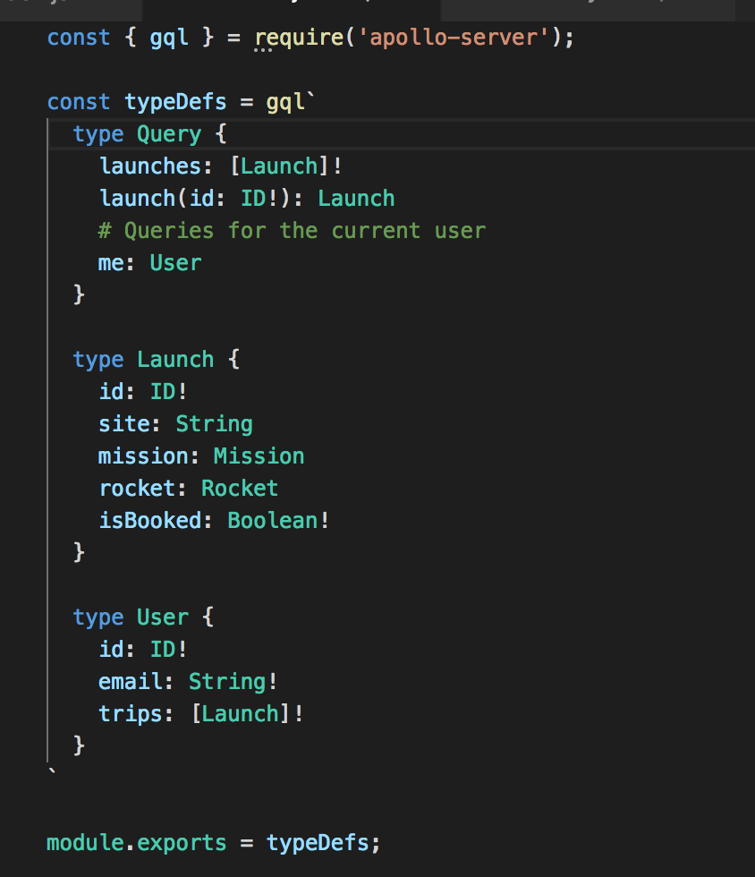
Schema
Notes:
What’s awesome about GraphQL is that the shape of your query will match the shape of your response.
A schema also defines what data we can fetch through queries
and what data we can update through mutations
Since all types in GraphQL are nullable by default, we need to add the ! to indicate that our query will always return data.
Next, we define a query to fetch a launch by its ID. This query takes an argument of id and returns a single launch.
Finally, we will add a me query to fetch the current user's data.

Slide 26
The shape of your Query (schema)
will match the shape of your response!
select id, rocket, mission from database

Slide 27
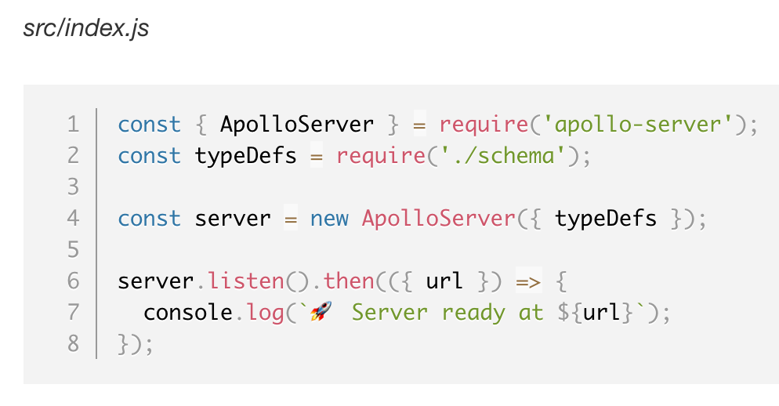
Define your Apollo server
Notes:
Apollo Server is a library that helps you build a graph API over your data. It can connect to any data source, including REST APIs and databases
Apollo Server will now be available on port 4000.

Slide 28
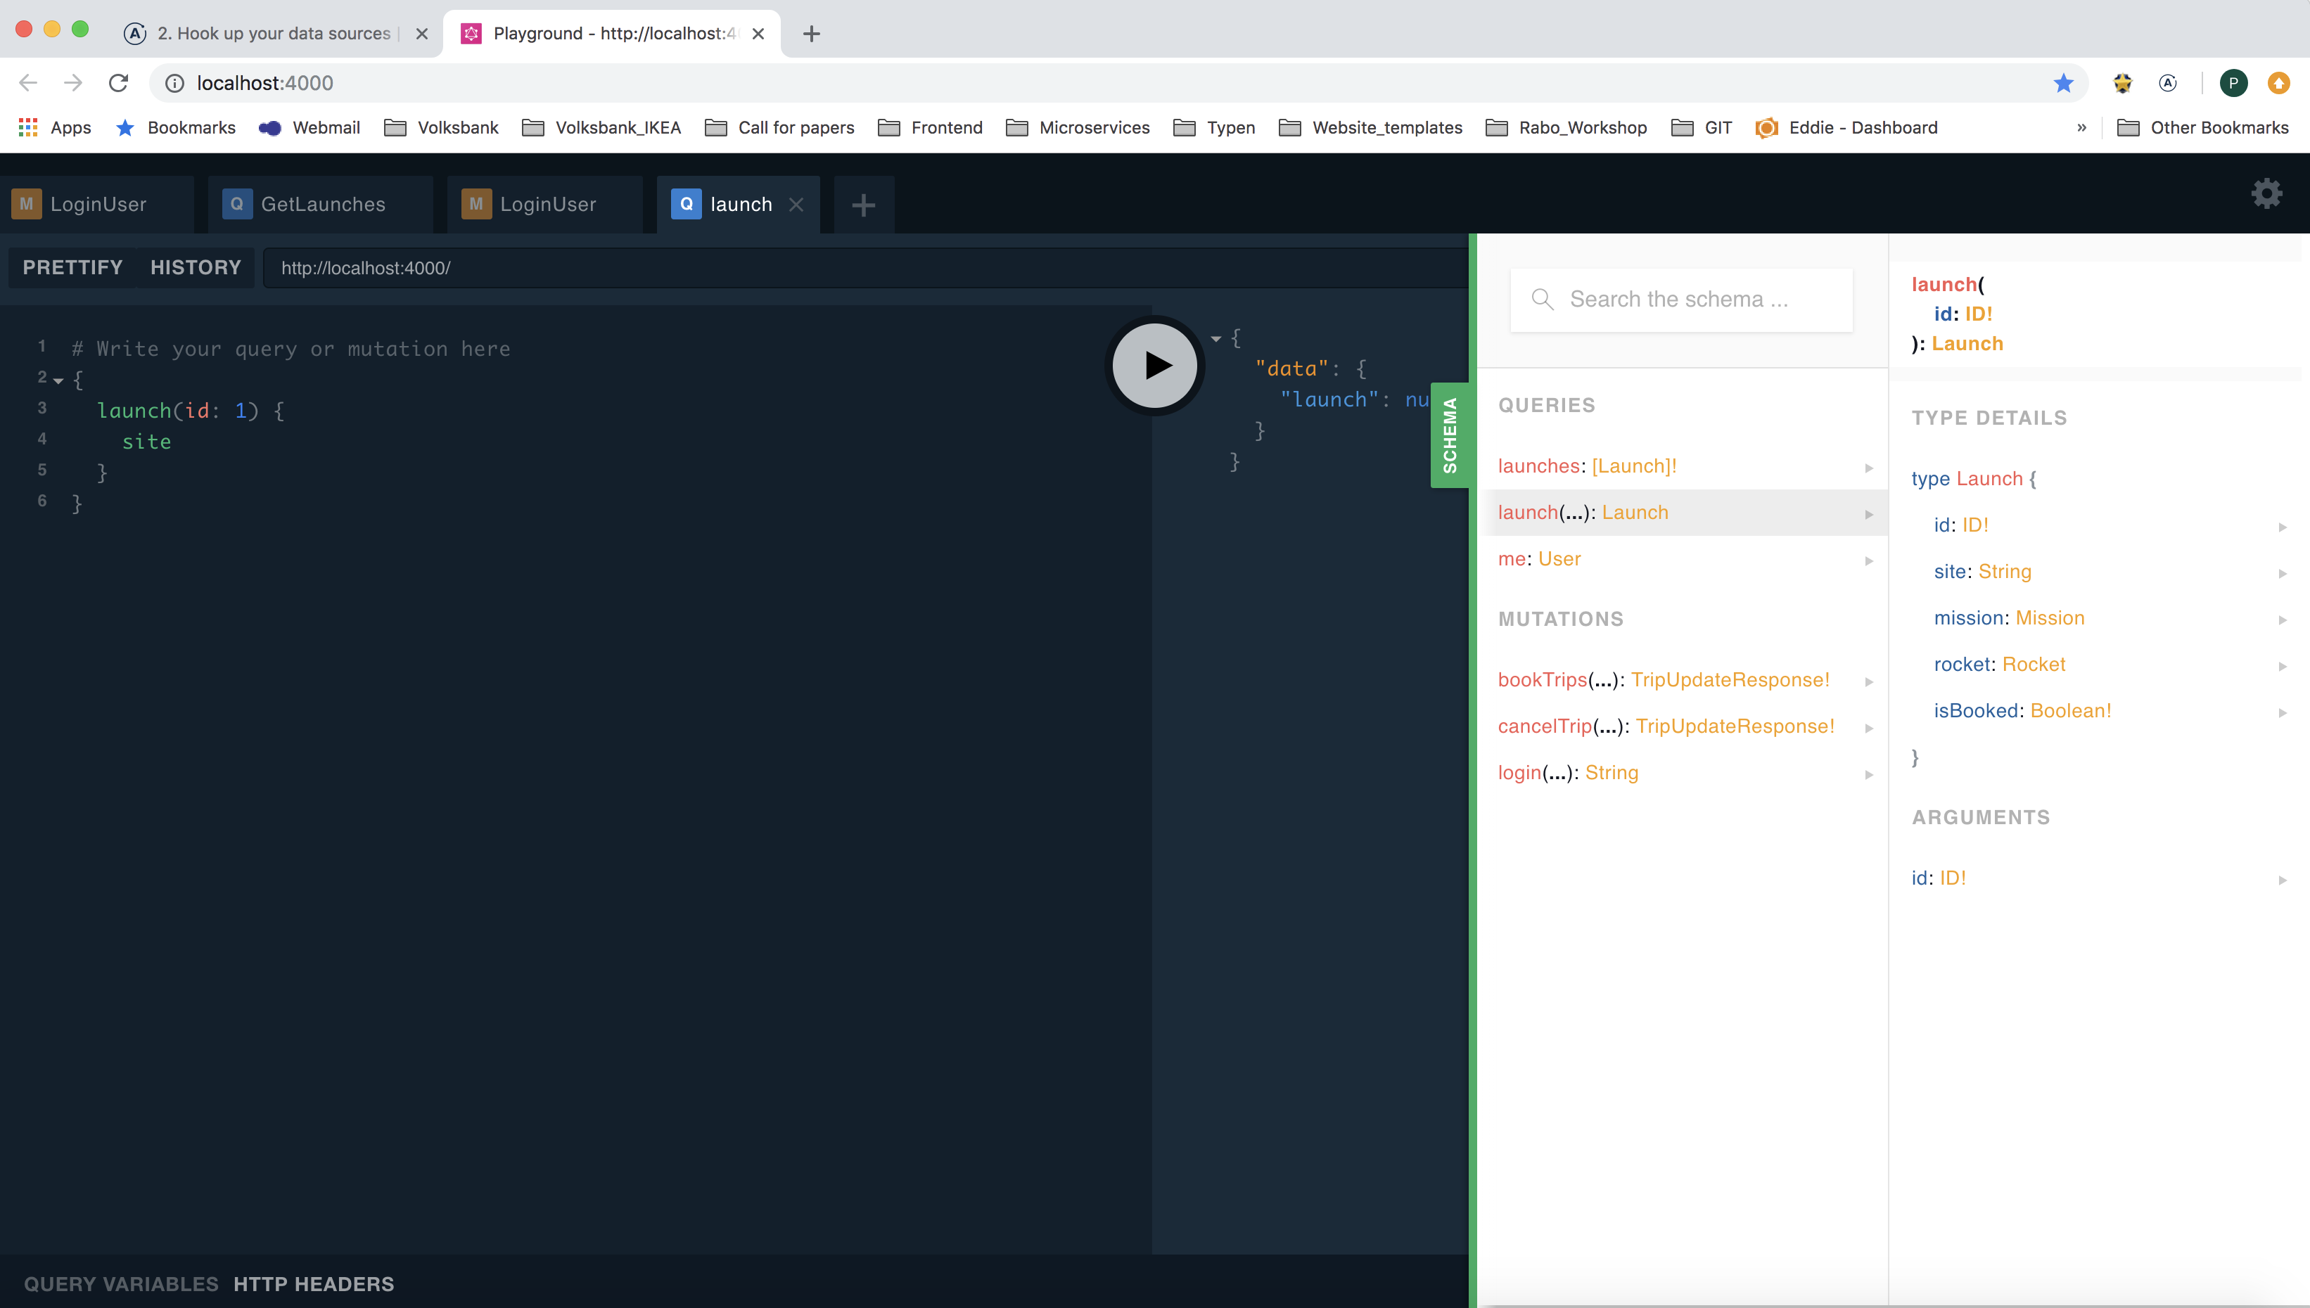
Test your schema in GraphQL Playground
Notes:
The Playground is an interactive, in-browser GraphQL IDE for exploring your schema and testing your queries.

Slide 29
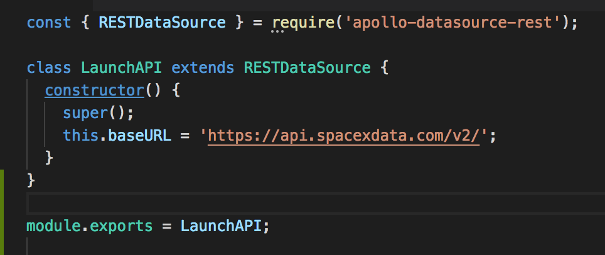
Step 2: Write your Datasources

Slide 30
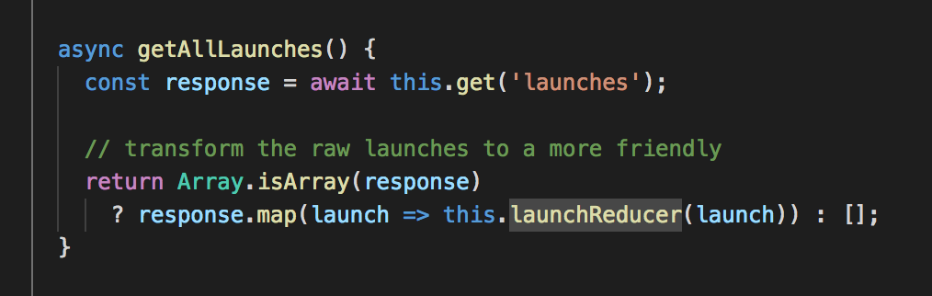
getAllLaunches via DataSource
this = DataSource
https://api.spacexdata.com/v2/launches
Notes:
this = baseURL ( the REST data sources)
The Apollo REST data sources has helper methods that correspond to HTTP verbs like GET and POST.
In the code above, this.get('launches'), makes a GET request to https://api.spacexdata.com/v2/launches and stores the returned launches in the response variable.
Then, the getAllLaunches method maps over the launches and transforms the response from our REST endpoint with this.launchReducer.

Slide 31
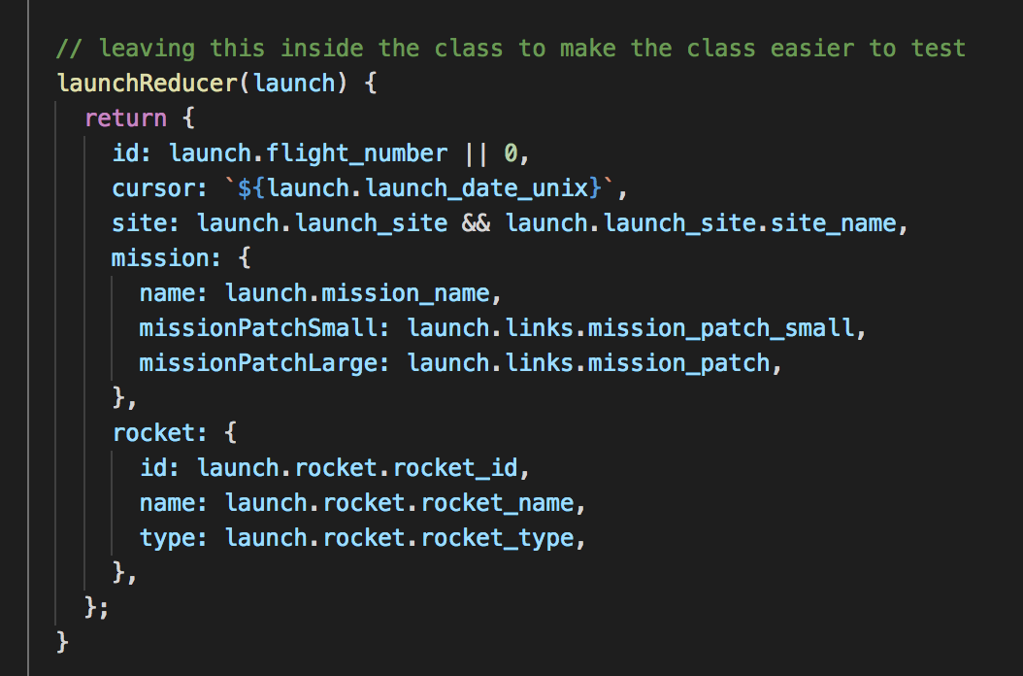
Write a parser (reducer)
Notes:
Now, we need to write our launchReducer method in order to transform our launch data into the shape our schema expects.

Slide 32
Step 3: Get your data with Resolvers
Learn how a GraphQL query fetches data

Slide 33
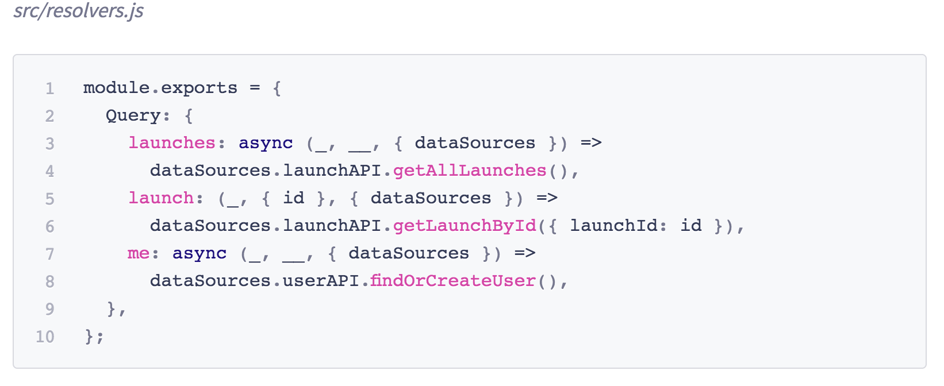
Write Query Resolvers
Notes:
The code above shows the resolver functions for the Query type fields: launches, launch, and me.
The first argument to our resolvers, parent, is always blank because it refers to the root of our graph.
The second argument refers to any arguments passed into our query, which we use in our launchquery to fetch a launch by its id.
Finally, we destructure our data sources off the third argument, context, in order to call them in our resolvers.

Slide 34
Schema
Notes:
What’s awesome about GraphQL is that the shape of your query will match the shape of your response.
A schema also defines what data we can fetch through queries
and what data we can update through mutations
Since all types in GraphQL are nullable by default, we need to add the ! to indicate that our query will always return data.
Next, we define a query to fetch a launch by its ID. This query takes an argument of id and returns a single launch.
Finally, we will add a me query to fetch the current user's data.

Slide 35
Notes:
Het bouwen van een interactieve app om je plek te reserveren voor een aankomende Space-X-lancering.
Alle gegevens zijn echt, dankzij de SpaceX API.
https://www.apollographql.com/docs/images/space-explorer.png
De app heeft vijf schermen: een inlogscherm, een lijst met lanceringen, een startdetail, een profielpagina en een winkelwagentje.
De grafische API die onze Space-app van stroom voorziet, maakt verbinding met een REST-API en een SQLite-database.
We behandelen essentiële onderwerpen zoals: authenticatie, paginering, testen en implementatie.

Slide 36
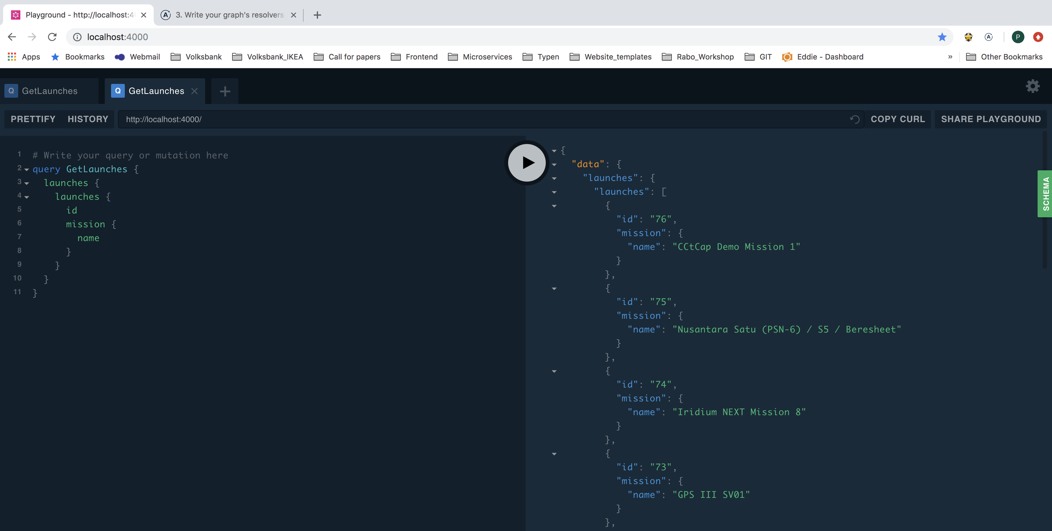
Run Queries in GraphQL Playground
Notes:
What's awesome about GraphQL is that the shape of your query will match the shape of your response.

Slide 37
Final flow
Notes:
Resolver roept de ‘Data Source’ aan voor het connecten naar de API. →
Reducer (in order to transform our data into the shape our schema ) → schema → to Frontend

Slide 38
Question
Is GraphQL a Database Technology?
Notes:
No. GraphQL is often confused with being a database technology. This is a misconception, GraphQL is a query language for APIs - not databases. In that sense it’s database agnostic and can be used with any kind of database or even no database at all.

Slide 39
Question
Is GraphQL only for Javascript/Frontend Developers?
Answer: a GraphQL SERVER can be implemented in any programming language
Notes:
No. GraphQL is an API technology so it can be used in any context where an API is required.
On the backend, a GraphQL SERVER can be implemented in any programming language that can be used to build a web server.
Apollo is written in Node
GraphQL can be Node/Java/C# ect.

Slide 40
Question
Is Apollo only for Javascript/Frontend Developers?
Answer: Yes, Apollo is written in Node and can be used in the Frontend
Notes:
Yes, Apollo is written in Node and can be used in the Frontend
GraphQL can be Node/Java/C# ect.

Slide 41
Question
How to do Authentication and Authorization?
Notes:
Authentication in GraphQL can be implemented with common patterns such as OAuth.
Authorization: Delegate authorization logic to the business logic layer https://graphql.org/learn/authorization/

Slide 42
Where should you define business logic?
Notes:
Where should you define the actual business logic? Where should you perform validation and authorization checks? The answer: inside a dedicated business logic layer. Your business logic layer should act as the single source of truth for enforcing business domain rules.
In the diagram above, all entry points (REST, GraphQL, and RPC) into the system will be processed with the same validation, authorization, and error handling rules.
GraphQL should focus on What the use needs. NOT How !!!

Slide 45
Start Tutorial
https://www.apollographql.com/docs/tutorial/schema.html
Skip step 4: “Run your graph in production”

Slide 46
Instructions
There are two folders: one for the starting point (start/) and one for the final version (final).
Within each directory are two folders: one for the server and one for the client.
We will be working in the server folder first.

